Slide 1
Disassemble Incline strengthen round tube steps
Step 1~Step 4

Slide 2
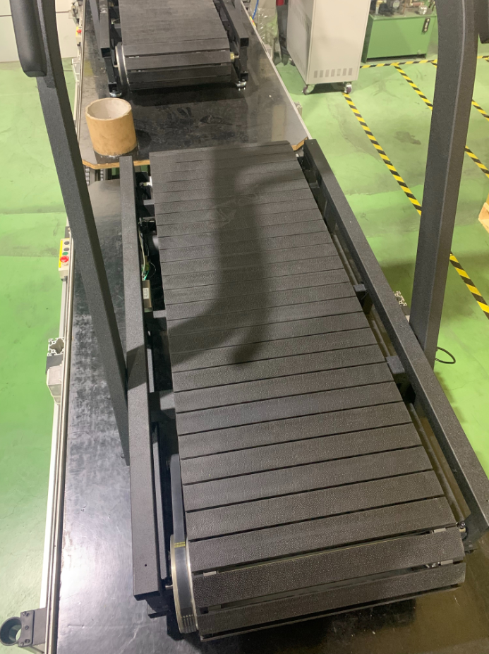
Step 1. Please remove pedal on both sides and front/rear end cap
請移除左右踏板以及前後調整盒

Slide 3
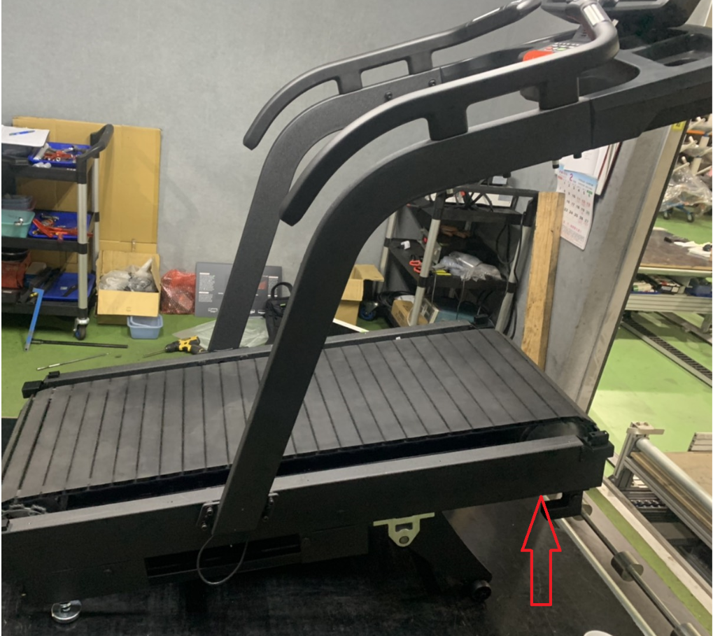
Step 2. Adjust incline to 15 levels and cut the power 升起揚升至15段並斷電

Slide 4
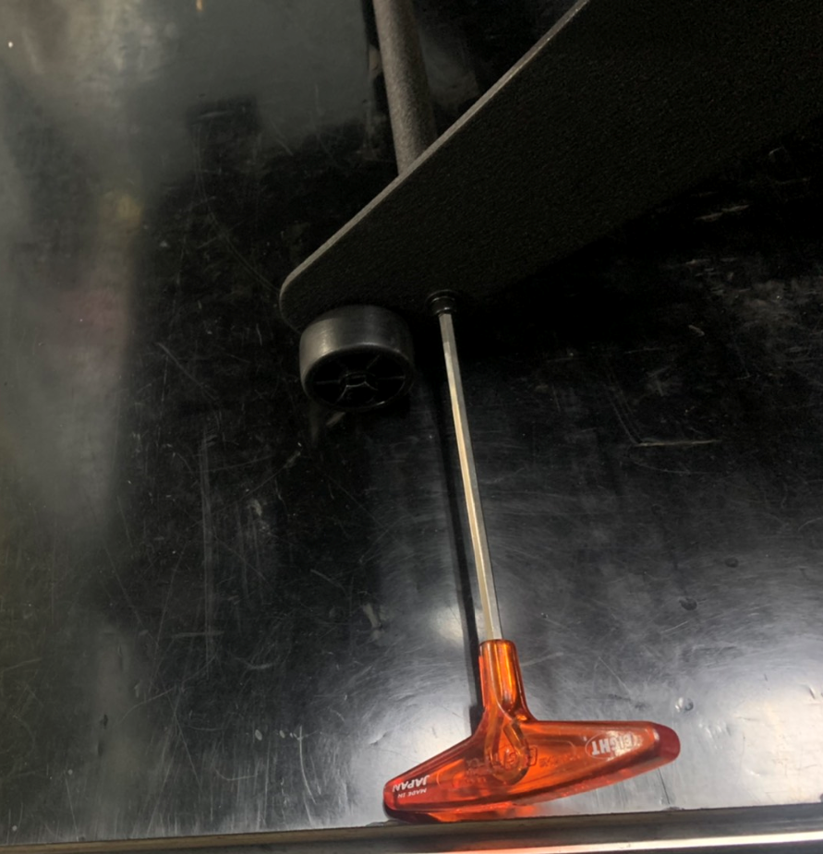
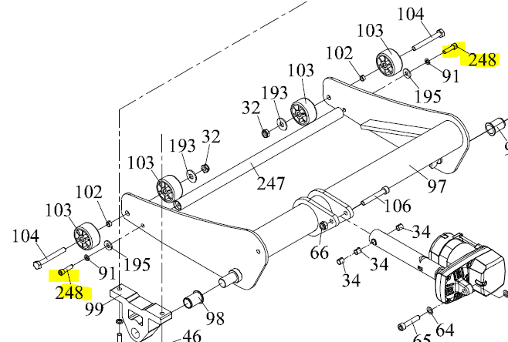
Step 3. Loose Incline strengthen round tube screw (no.248) near the wheel on left and right side
鬆開揚升補強桿螺絲(左右邊皆須鬆開)

Slide 5
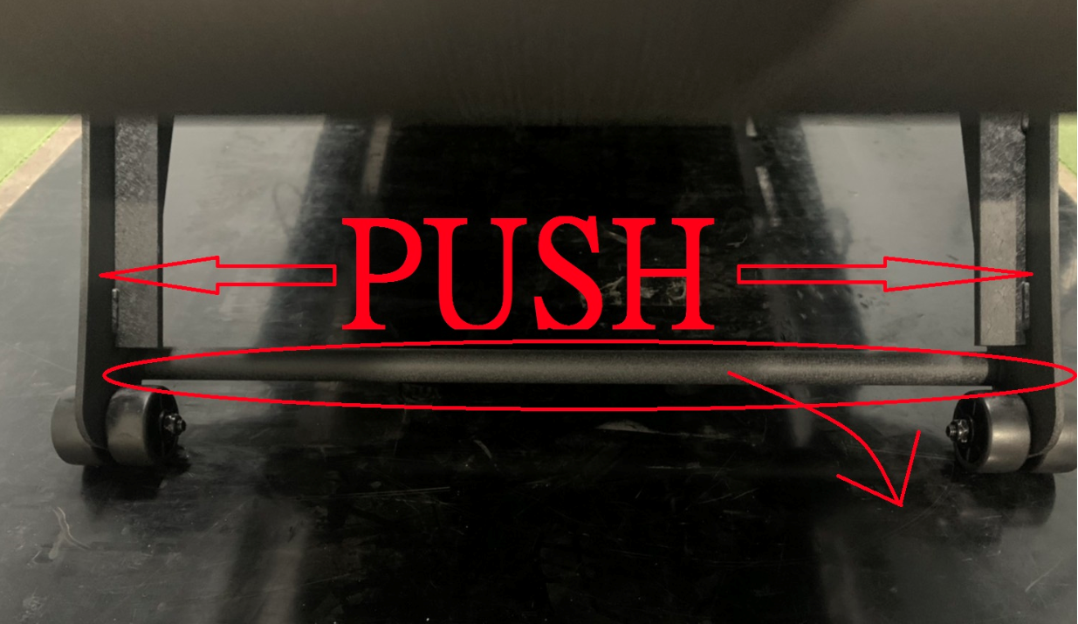
Step 4. Remove Incline strengthen round tube as following picture
移除揚升補強桿(建議兩側要撐開比較好拿)

Slide 6
Assemble timing belt steps
Step 1~Step 12

Slide 7
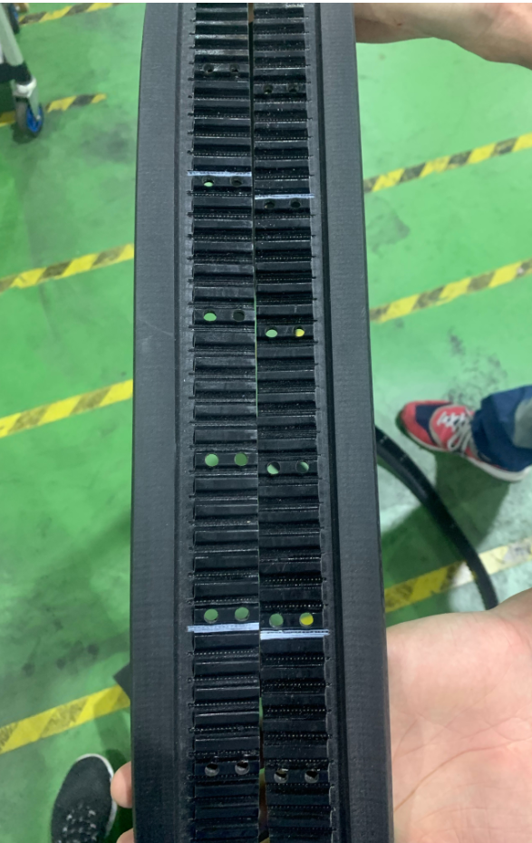
Step 1. Prepare your timing belt and check where is line mark as picture on right hand side 確認準備好的時規皮帶的記號位置

Slide 8
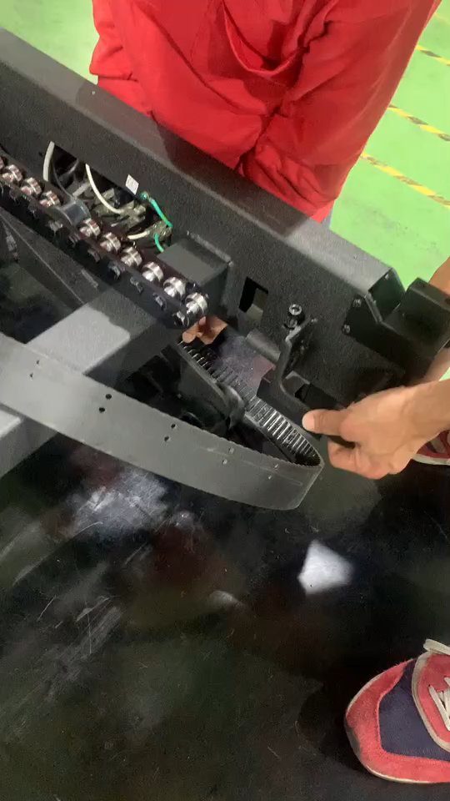
Step 2(video). Lift up the front frame to put timing belt 抬起車架前方將時規皮帶放入
P.S move mouse to picture and the play icon will show up

Slide 9
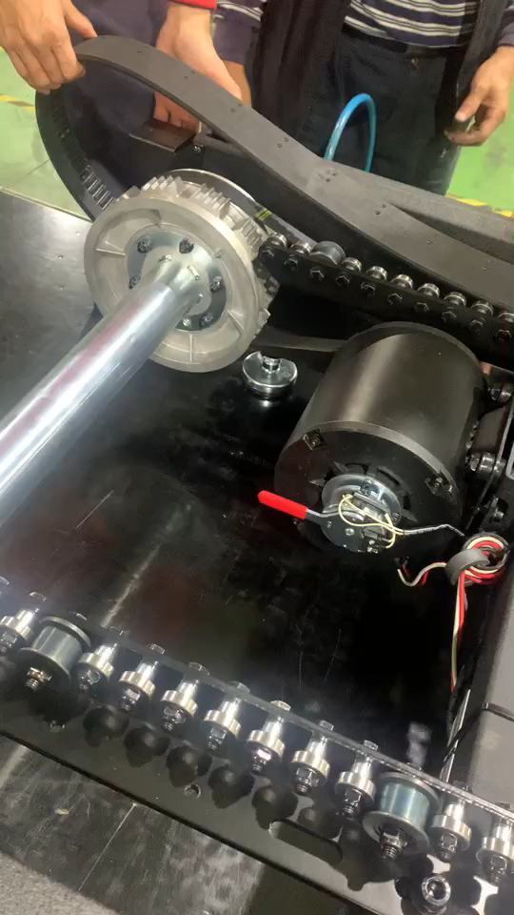
Step 3(video). Lift up the back frame to put timing belt 抬起車架前方將時規皮帶放入
P.S move your mouse to picture and the play icon will show up

Slide 10
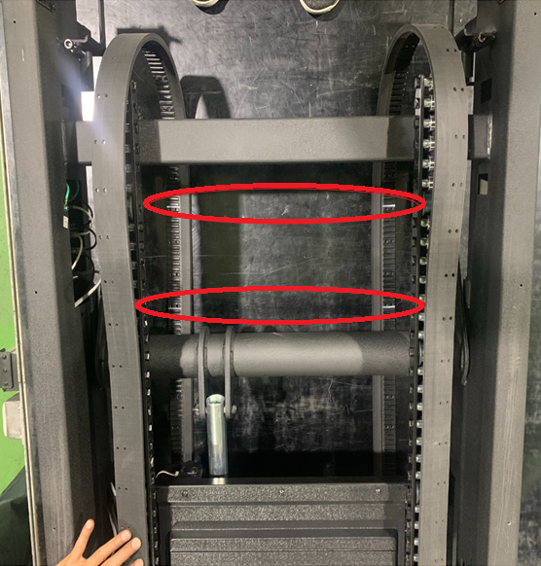
Step 4. Make sure to align the mark for both side 確認記號位置兩邊相互對齊

Slide 11
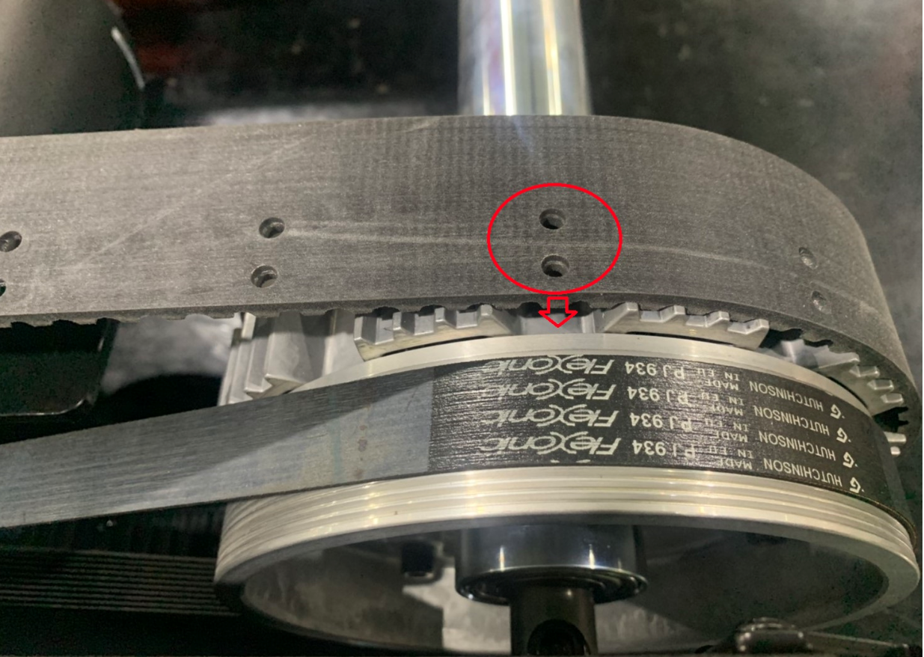
Step 5. Put the hole of timing belt in the middle groove that between rear roller gear and gear 將時規皮帶之打孔處置於後滾筒齒與齒的中間凹槽

Slide 12
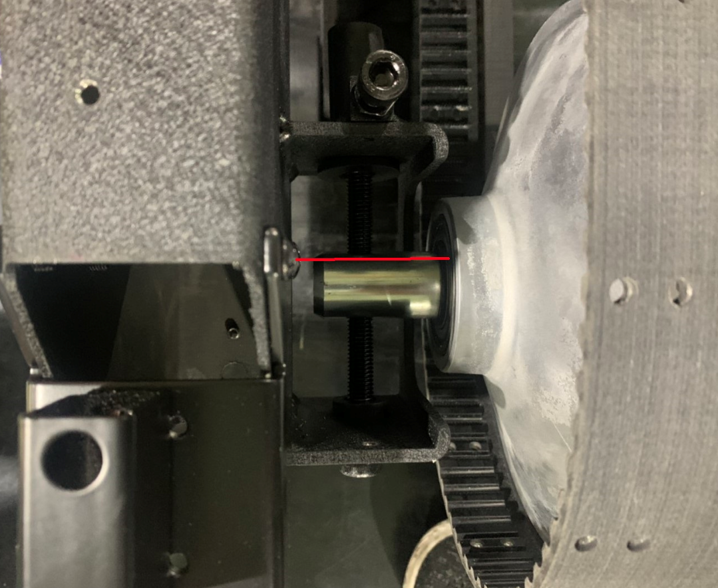
Step 6. Put in front roller and fasten the screw until front roller position is parallel with screw(look down from above) 放入前滾筒並將螺絲鎖緊，前滾筒位置約與螺絲平行處(正上方視角)

Slide 13
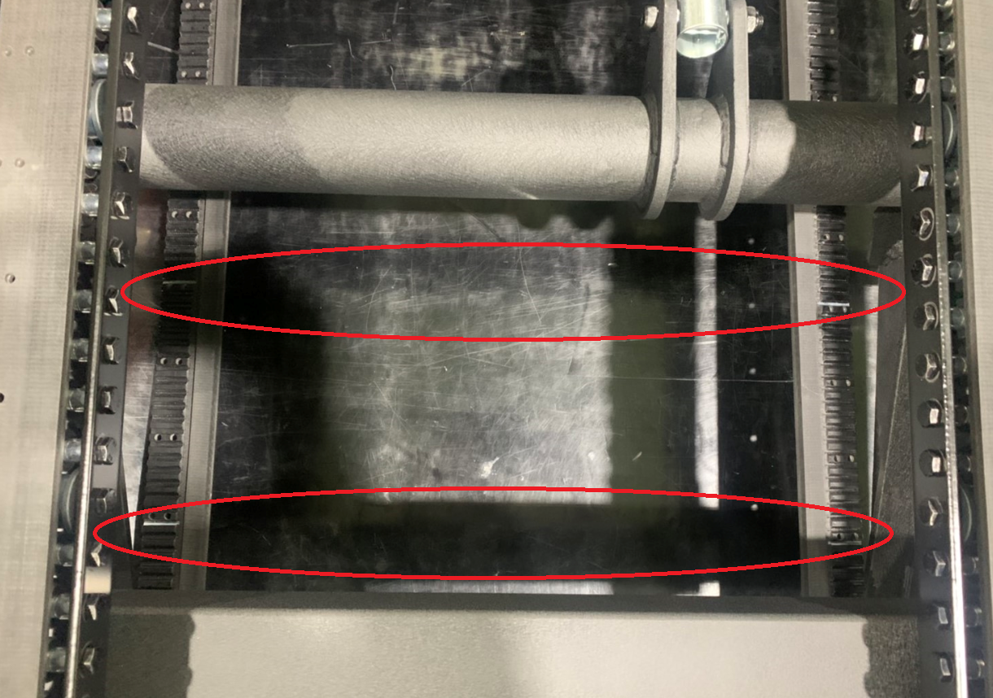
Step 7. double check the mark of timing belt is aligned for both side 再次確認記號位置對齊

Slide 14
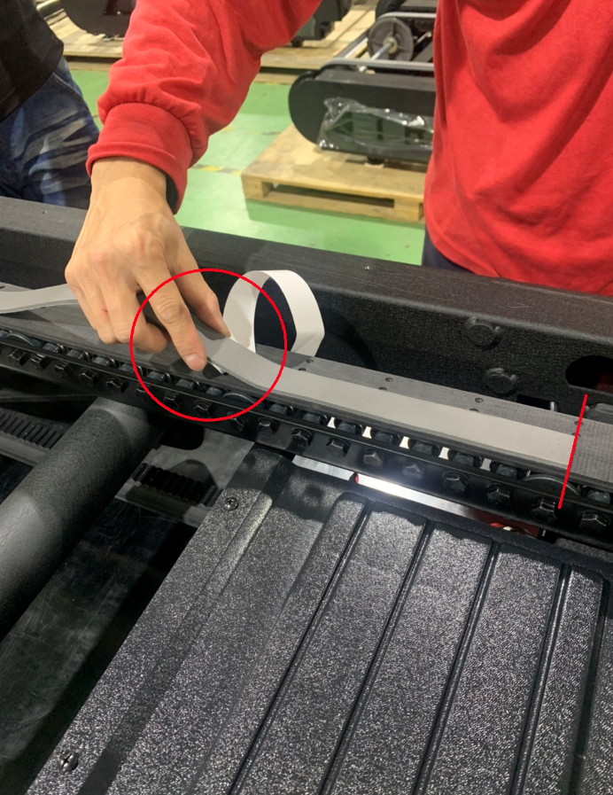
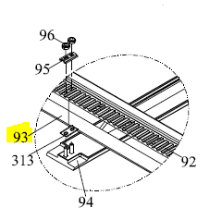
Step 8. Stick 93. BAM9000-250-30 rubber pad from the hole on timing belt. Please use same method to stick it, put them gently do not try to extend it. 貼上泡棉，請由時規上的孔處開始張貼，兩邊時規皆需保持相同的張貼狀況。張貼泡棉時，雙手以自然方式放置泡棉(參考手勢)，勿拉伸泡棉

Slide 15
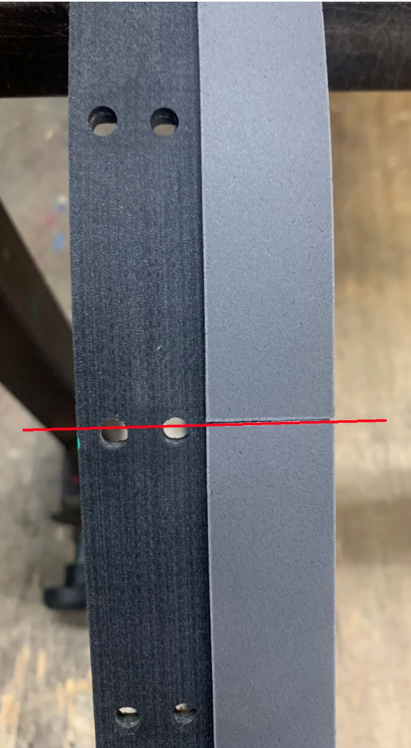
Step 9-1. Align to the hole then stick the rubber pad continuously (4 rubber pads on each timing belt) 以切齊孔位方式連續張貼泡棉(一邊時規需要四條泡棉)

Slide 16
Step 9-2. We highly recommend rubber pad seam can exactly on half of the hole, this will be good look and not easily drop off. 建議泡棉接縫處剛好在孔位的一半，較美觀跟不易脫落

Slide 17
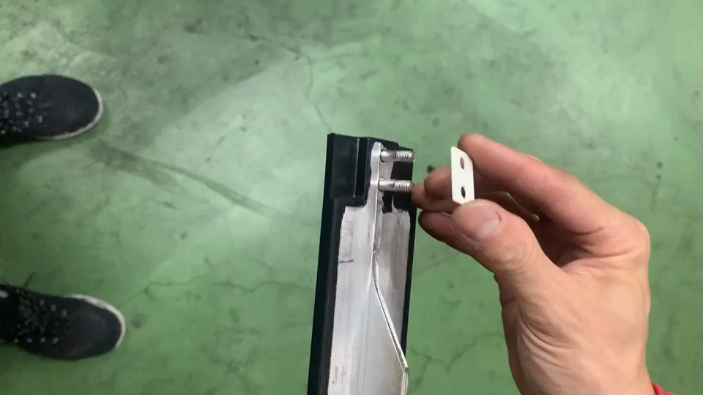
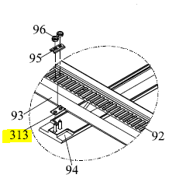
Step10(video). Put the 313. P-5123 Pedal gasket on rubber pedal 放置尼龍墊片
P.S move your mouse to picture and the play icon will show up

Slide 18
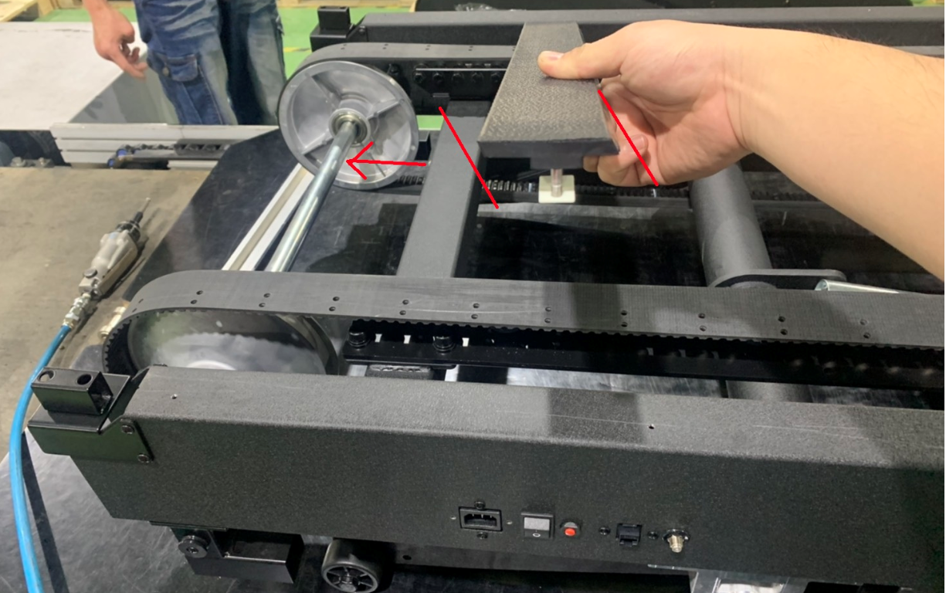
Step 11. Check the direction of peal (note: It’s look down from above angle. If need to lock the screw, kindly rotate pedal together) 確認跑帶方向(請注意 此為上方視角方向，若旋轉至下方要組螺絲時也需一併選轉跑帶)

Slide 19
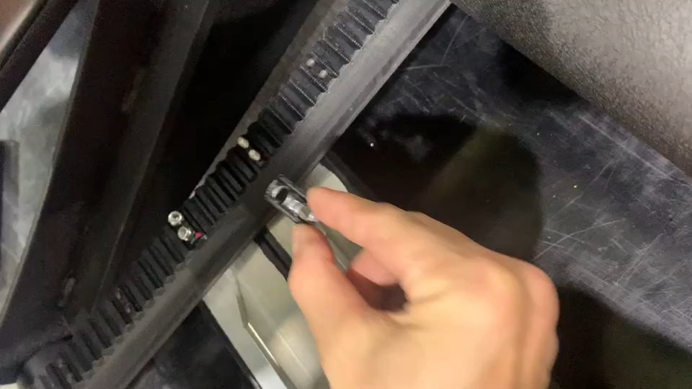
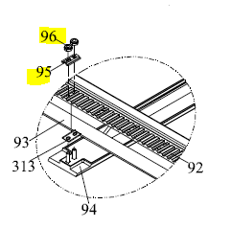
Step12(video). Put on no.95 pad plate and lock 96. nylon nut 放上鐵片，並繫上螺帽
P.S move your mouse to picture and the play icon will show up

Slide 20
Recover everything same as how you disassemble at the beginning

